Slide 1
Java-based Multi-Banking System Project
Submitted By:
Deepashri Dabhade- 21BAI10325
Ashmit Pandey- 21BAI10338
Harsh Chaturvedi- 21BAI10324
Guided By:
Dr. Komarasamy G.

Slide 2
Contents
Sr. No. | Title | Page No.
1. | Objectives | 4
2. | Abstract | 5
3. | Introduction | 6
4. | Literature Work | 7-10
5. | Existing work | 11
6. | Proposed Work | 12-13
7. | Overall Architecture diagram and flow diagram | 15
8. | Software Used | 16

Slide 3
Contents
Sr. No. | Title | Page No.
9. | Experimental results | 17-20
10. | Conclusion and future work | 21
11. | Reference | 22
12. | Contribution of all the members | 23

Slide 4
Objectives
This banking system project's goal is to create a system that will join several bank accounts to a single software-based system.
It will give users access to all bank services through a single interface in a simple and quick manner.
A person who uses this system can sign in to the multi-banking system and access their bank accounts even if they have multiple accounts with the same bank or other banks.
Therefore, this system will offer a framework that will connect all of a person's banks in a single location.

Slide 5
Abstract
Java-based Bank Application System, where Object-Oriented Programming meets financial prowess.
With encapsulated security, seamless inheritance of features, and polymorphic transaction processing, we offer you a dynamic and robust banking experience.
Utilizing Java's multi-threading capabilities, we ensure concurrent user interactions, while Exception Handling guarantees a glitch-free interface.
This is a synchronized journey of data abstraction and real-time financial management. We aim to proceed towards a digital banking revolution, with Java at the helm.

Slide 6
Introduction
The goal of this project is to provide customers with a simple and practical way to access their bank accounts.
Customers can integrate their financial activities within a unified hub using the suggested solution, saving them the hassle of managing different online or physical accounts.
The project aims to give customers the tools they need to manage their banking operations with the utmost simplicity by giving them a thorough picture of multiple accounts, transaction histories, and account details.

Slide 7
Literature Work
Sl. No. | Title of the Paper | Journal Name, Publisher Name, Year of Publication and Volume & Issue Number (Only SCI) | Author Name | Problem Addressed / Problem Statement | Methods/ Technologies Used | Author Contribution | Shortcomings/ Deficiency / Assumption Made (Research Gap)
 | Overview of intelligent online banking system based on HERCULES architecture | IEEE, IEEE Access, 2020 Digital Object Identifier 10.1109/ACCESS.2020.2997079 | Guangsheng Luo, Wenwei Li, Yuzhong Peng. | Addressed Multiple banking system with Hercules and ML. | Hercules Architecture, Machine Learning, Banking Knowledge | Graduate student of IEEE. Helped in revise and discover algorithms. | Demand analysis was not possible.
2. | Banking system based on user acceptance test. | IEEE, doi.org/10.1109/ITSIM.2010.5561337,June 2010. | Halimah B.Z, Azlina A, T.M. Sembook. | Banking systems implementing the Islamic worldview. | User Acceptance test, HiCore architecture. | Faculty of Malaysian university. Studied the Islamic World View and developed accordingly. | Difficult to reach the local markets.

Slide 8
Literature Work
Sl. No. | Title of the Paper | Journal Name, Publisher Name, Year of Publication and Volume & Issue Number (Only SCI) | Author Name | Problem Addressed / Problem Statement | Methods/ Technologies Used | Author Contribution | Shortcomings/ Deficiency / Assumption Made (Research Gap)
3. | Multi banking integrated system. | IEEE, July 2012, https://doi.org/10.1109/ICCCNT.2012.6395858 | P.Iyappan, R.Amarnath. | Service Oriented Architecture (SOA) implemented. | Service Composition, Internet Banking. | Implemented Service Oriented Architecture. . | Database handling can be improved.
4. | Traditional approach of Multilevel authentication for online banking | Jirp.org https://ijrp.org/filePermission/fileDownlaod/4/a9503f77c7fede8f2d2d9335a1e87b39/1 | S Aruna Selvi , Dr. P.Kumar | Secured net banking based algorithm | Online banking , JDBC , DBMS | Usage of system | Complex descriptors which might be insensitive to scaled rotation

Slide 9
Literature Work
Sl. No. | Title of the Paper | Journal Name, Publisher Name, Year of Publication and Volume & Issue Number (Only SCI) | Author Name | Problem Addressed / Problem Statement | Methods/ Technologies Used | Author Contribution | Shortcomings/ Deficiency / Assumption Made (Research Gap)
5. | Multilevel Contracts for Trusted Components | arxiv.org https://arxiv.org/pdf/1010.2827.pdf | Mohamed Messabihi,Christian Attiogb´e | Components have rich interface descriptions | user-defined data types and related statements; | contracts can be defined at different levels | Use of unstructured files not possible.
. 6. | Real time warning module for bank financial supervision system. | IEEE,ICCSEC, August 2018, doi:10.1109/iccsec.2017.8446719. | Jian Zhang | Preventing multiple banking risks. | Machine Learning, Discriminant Analysis. | Developed ML models and performed analysis. | Analysis was not structured.

Slide 10
Literature Work
Sl. No. | Title of the Paper | Journal Name, Publisher Name, Year of Publication and Volume & Issue Number (Only SCI) | Author Name | Problem Addressed / Problem Statement | Methods/ Technologies Used | Author Contribution | Shortcomings/ Deficiency / Assumption Made (Research Gap)
7. | Scurity challenges in designing an integrated web app. for online banking | IEEE,2010 https://sci-hub.se/https://ieeexplore.ieee.org/document/5561291/ doi: 10.1109/itsim.2010.5561291 | Annie Ai Nee Ng , Nasuha Lee Abdullah | Current online banking only allows payment to be paid from single account | Integrated web application , security solution | Secured integrated web applications for multiple online banking service | It is not properly secured
.8. . | MDFT filter bank multicarrier systems with multiple transmission zeros | IEEE 2011, https://sci-hub.se/https://ieeexplore.ieee.org/document/5937600/ doi:10.1109/iscas.2011.5937600 | Fernando cruz roldan , juan I. godino | focused on nearly perfect reconstruction systems | Filter bank multicarrier systems , nearly perfect reconstruction | A new scheme embedding MDFT FBMC into DFT | performance of proposed systems compared to conventional OFDM

Slide 11
Existing work
The existing banking system lacks a unified solution for managing multiple bank accounts. Customers are required to manage various accounts separately, both online and offline.
This fragmented approach necessitates remembering different account details for each bank. This lack of integration leads to inefficiencies and user inconvenience.
The proposed Banking System Project aims to address these issues by creating a comprehensive multi-banking platform. This system will offer users a single interface to access and manage all their bank accounts, streamlining their financial interactions.
The project includes modules for banks to manage customer details and transactions, a customer module for accessing and conducting transactions across multiple accounts, an admin module for system control, and a report module for generating system metrics.

Slide 12
Proposed work
Initiation: Define project scope, stakeholders, and create a plan.
Requirement Gathering: Understand user needs and bank requirements.
System Design: Create an architecture and design UI and database.
Technology Selection: Choose suitable technologies and tools.
Development: Build bank, customer, admin, and report modules.
Integration and Testing: Integrate modules, perform testing, and validate with users

Slide 13
Proposed work
7. Security and Data Privacy: Implement security measures and comply with regulations.
8. Deployment: Launch the system on a server, ensuring scalability.
9. User Training and Documentation: Train users and create user manuals.
10. Launch and Maintenance: Roll out the system, monitor, and address issues.
11. Continuous Improvement: Gather feedback, make updates, and enhance the system over time.

Slide 14
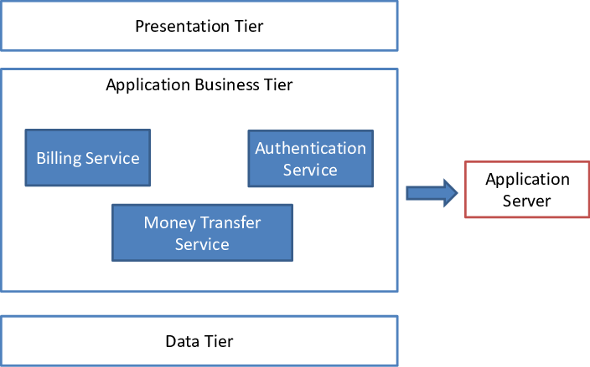
Overall Architecture diagram and flow diagram

Slide 15
Software used
Software and Hardware details with Justification
S.No | Software used | Justification
 | Java Programming Language: | Java is a versatile and widely-used programming language that offers platform independence and strong support for building robust, scalable applications. Its object-oriented nature and extensive libraries make it suitable for developing complex software systems like the multi-banking system.
S.No | Hardware used | Justification
 | RAM 128 MB Disk Space 124 MB for JRE, 2 MB for JAVA update | RAM is a short-term memory pool where your computer keeps information it needs to access fast. RAM keeps data readily available so your processor can process tasks right away without having to search for it in long-term storage.

Slide 16
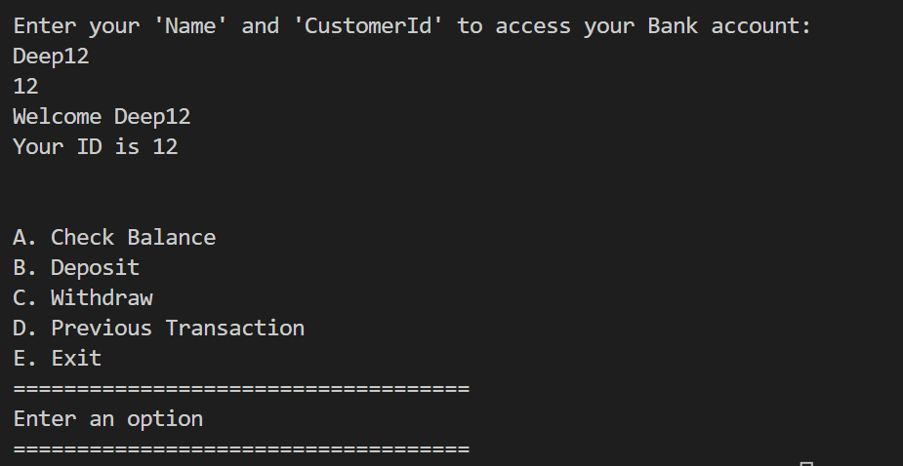
Experimental results

Slide 17
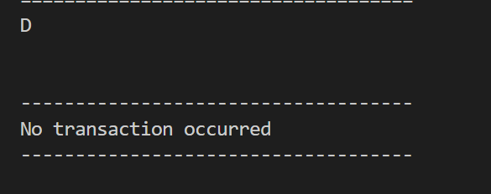
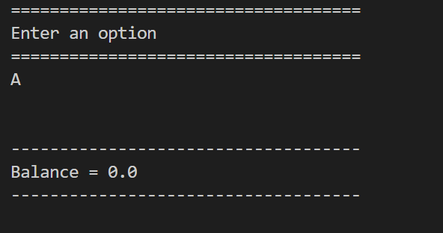

Slide 18
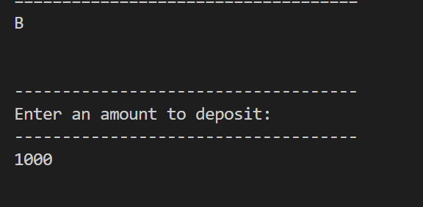
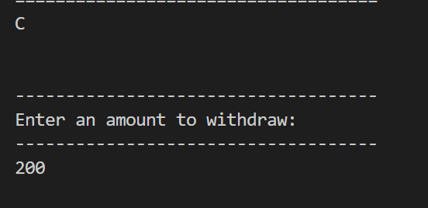

Slide 19
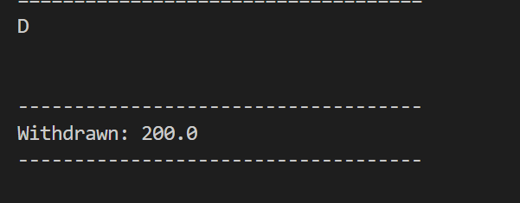
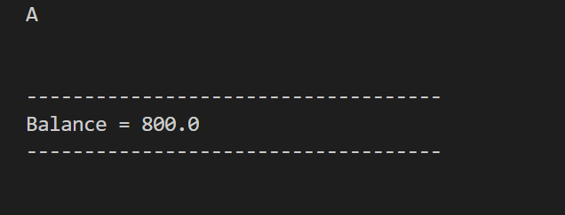

Slide 20
Conclusion and future work
The Banking System Project offers a software-based solution that unites these accounts under a single, user-friendly interface to solve the difficulties of managing several bank accounts across institutions.
For users, banks, and administrators, this project seeks to improve efficiency, increase accessibility, and streamline financial interactions.
The concept promises a streamlined and integrated banking experience that addresses the present fragmented approach.
This is accomplished through different modules, a responsive user interface, and robust technology options.

Slide 21
Reference
https://sci-hub.se/https://www.sciencedirect.com/science/article/abs/pii/S0305048317313063
https://sci-hub.se/https://ieeexplore.ieee.org/abstract/document/5561337
https://sci-hub.se/https://ieeexplore.ieee.org/abstract/document/6395858/references#references
https://ieeexplore.ieee.org/stamp/stamp.jsp?arnumber=9099293
https://ijrp.org/filePermission/fileDownlaod/4/a9503f77c7fede8f2d2d9335a1e87b39/1
https://www.scribd.com/document/216789038/Multi-Banking-System-Documentation
https://sci-hub.se/https://ieeexplore.ieee.org/document/8446719
https://sci-hub.se/https://ieeexplore.ieee.org/document/5937600/
https://sci-hub.se/https://ieeexplore.ieee.org/document/5561291/

Slide 22
Contribution of all the members
S.No | Roll No | Name | Contribution
1. | 21BAI10324 | Harsh Chaturvedi | PPT
2 | 21BAI10325 | Deepashri Dabhade | Idea,Code,Implementation,PPT
3 | 21BAI10338 | Ashmit Pandey | Code,Implementation,PPT

